Slide 1
CROWDSOURCING PLATFORM Titled as: PROCONNECT
Submitted by- Anjani Shaw
Roll no.-2305260004,
Master’s in computer application 4th sem
Rourkela institute of management studies

Slide 2
INTRODUCTION
It is an online tool that connects businesses or individual with a large group of people so called crowd to solicit services ideas or contributions for a specific task or project.
Crowdsourcing is a process where businesses or individuals leverage the collective intelligence and creativity of a large group of people, often through online platforms, to solve problems, generate ideas, or complete tasks.
It's a way to tap into a broader pool of talent and expertise than traditional methods, allowing for faster and more cost-effective solutions. The term "crowdsourcing" was coined by Jeff Howe in 2006, blending "crowd" and "outsourcing" to describe this approach.
Crowdsourcing projects work with or without payment. The best-known example of a crowdsourcing project in which crowd workers are not paid is the online encyclopedia Wikipedia. It is a crowdsourcing platform where anyone can contribute, and everyone can edit or improve the content.
Examples of Crowdsourcing Platforms:
99designs:
A platform for design contests, where businesses can solicit design ideas from a global community of designers.
Upwork:
A platform for freelancers to find work and clients to hire them, including crowdsourcing projects.
InnoCentive:
A platform that connects companies with problems to crowdsource solutions.

Slide 3
CONTINUE…
ProConnect is a modern freelancing platform built to connect skilled professionals with clients from around the world. We’re here to redefine how freelancers and businesses collaborate—making it faster, simpler, and more secure.
Our platform offers a professional environment where freelancers can showcase their expertise, find relevant projects, and build lasting client relationships, while businesses can easily discover and hire top-tier talent tailored to their needs.
ProConnect caters to a wide range of industries, including technology, design, writing, marketing, business consulting, and more—ensuring diverse opportunities for freelancers and a broad talent pool for clients.
We use smart matching algorithms that help clients connect with freelancers who best fit their project requirements, based on skills, experience, ratings, and availability.
Our mission is simple: to bridge the gap between brilliant minds and forward-thinking businesses. With a user-friendly interface, secure payment systems, and a wide range of categories, ProConnect makes freelancing efficient, reliable, and rewarding.

Slide 4
PROBLEM STATEMENT
Freelancers struggle to find consistent and quality work, especially when starting out, due to high competition and lack of visibility on existing platforms.
Clients face difficulty identifying reliable and skilled freelancers, often leading to mismatched hires, delays, or subpar project outcomes.
Lack of trust and transparency due to fake profiles, unverifiable portfolios, and unreliable reviews makes it hard to make informed hiring or project decisions.
Payment delays and disputes are common, with limited protection for either party, leading to frustration and financial risk.
There is no all-in-one platform that seamlessly combines smart talent matching, project management, secure payments, and a supportive community for growth.

Slide 5
ABSTRACT
ProConnect is a next-generation freelancing platform designed to bridge the gap between talented professionals and businesses seeking reliable, high-quality services. In an era where remote work is rapidly becoming the norm, ProConnect addresses the growing challenges faced by both freelancers and clients—ranging from poor job visibility, high service fees, and unreliable communication to difficulty in finding trusted, skilled talent.
By integrating smart job matching, secure milestone-based payments, project management tools, and a transparent rating system, ProConnect ensures seamless and efficient collaboration. The platform serves diverse industries, including technology, design, writing, marketing, and consulting, enabling freelancers to build their careers while helping businesses find the right talent effortlessly.
With a user-centric approach, ProConnect not only facilitates efficient hiring but also empowers freelancers to build their brand, develop long-term client relationships, and gain access to resources that support professional development. ProConnect aims to become a global hub for freelancing—where work is not just transactional, but meaningful, reliable, and future-ready.

Slide 6
Why We Need ProConnect?
In today's rapidly evolving digital economy, freelancing is no longer a side hustle—it's a full-fledged career path. Yet, many freelancers struggle to find consistent, high-quality work, while businesses are frustrated by inefficient platforms, poor talent matches, and high costs. Existing freelancing websites often fail to address key pain points such as trust, transparency, fair compensation, and long-term collaboration. ProConnect is designed to solve these problems by offering a streamlined, intelligent, and user-focused freelancing platform that benefits both freelancers and clients.
The purpose of ProConnect is to:
Bridge the gap between skilled freelancers and businesses seeking high-quality, dependable remote talent.
Simplify the freelancing process with a user-friendly platform that integrates job discovery, communication, task management, and payment.
Promote fairness and transparency through verified profiles, secure milestone-based payments, and honest reviews.
Empower freelancers to grow their careers through skill-based job matching, personal branding, and professional networking.
Help businesses save time and resources by providing quick access to pre-vetted, well-matched talent across various industries.

Slide 7
Project Scope
The scope of the ProConnect project includes:
✅ Platform Features:
User Registration & Profile Creation for both freelancers and clients
Smart Matching Algorithm to recommend freelancers or jobs based on skills, experience, and ratings
Job Posting and Proposal System with filters for categories, budget, timelines, etc.
Built-in Communication Tools including messaging, notifications, and file sharing
Project Management Dashboard for tracking progress, deadlines, and deliverables
Secure Payment System using escrow, milestone tracking, and transaction history
Ratings and Review System to ensure transparency and accountability
Admin Panel for managing users, content, payments, disputes, and support

Slide 8
SOFTWARE DEVELOPMENT LIFE CYCLE (SDLC)
FEASIBILITY STUDY
REQUIREMENT ANALYSIS AND SPECIFICATION
DESIGN
CODING AND UNIT TESTING
INTEGRATION AND SYSTEM TESTING
MAINTENANCE

Slide 9
FEASIBILITY STUDY
Economic Feasibility
• This project is economically feasible as it doesn’t require much. The only requirement is of a web browser along with any operating system.
• This is free for viewing on World Wide Web as a registered name.
• The people who use this can connect to the browser and this is the only thing that acts as a cost that is incurred in this application.
Technical Feasibility
• For the successful development of this application all we need is an internet connection, a database server and a supporting web server. This can be successfully implemented in Microsoft Edge environment and Chrome .

Slide 10
SOFTWARE REQUIREMENT SPECIFICATION
The purpose of this document is to define the software requirements for ProConnect, a web-based freelancing platform that connects freelancers with businesses seeking remote talent. It outlines the system’s functionality, performance, design constraints, and overall architecture.
• Operating Environment
VS CODE
JAVA
SPRING BOOT
MYSQL
GIT
GITHUB

Slide 11
FUNCTIONAL REQUIREMENT
User Registration and Login
Users can register as Freelancer or Client
Email verification is required
Login via email/password or third-party (Google, LinkedIn)
Profile Management
Freelancers: skills, experience, portfolio
Clients: profile, job history, payment verification
Editable dashboard with updates
Payment
Easy and direct payment
Admin-controlled dispute resolution system
Job Posting
Clients can post job listings with detailed scope, budget, and timeline
Freelancers can browse, filter, and apply to jobs
Proposal management interface for both parties
Project Management
Status tracking: Open, In Progress, Submitted, Completed
Admin Panel
User management (suspend/verify)
Job and content moderation
Financial report generation

Slide 12
NON-FUNCTIONAL REQUIREMENTS
Performance
The platform should handle up to 10,000 concurrent users with minimal latency.
Scalability
Microservices-based architecture for easy scaling as the user base grows.
Usability
Clean, modern, and responsive UI with accessibility standards..
Security
Encrypted user data and transactions (SSL, HTTPS, 2FA)
Role-based access control
Regular security audits and vulnerability scanning
Maintainability
Modular codebase with proper documentation
Continuous integration and deployment (CI/CD) pipeline

Slide 13
WHAT IS SPRING BOOT?
Spring Boot is an extension of the Spring Framework that simplifies the process of building and deploying Spring-based applications. It provides an easy and fast way to set up, develop, and run production-grade Spring applications with minimal configuration.
Spring Boot aims to reduce the complexity of using Spring by providing:
Auto-configuration: Automatically configures your application based on the dependencies in the classpath.
Standalone: Runs independently without needing an external server (uses embedded servers like Tomcat or Jetty).
Production-ready: Includes features like health checks, metrics, and externalized configuration via the Spring Boot Actuator.
Spring Initializr: A web-based tool to generate Spring Boot project templates quickly.

Slide 14
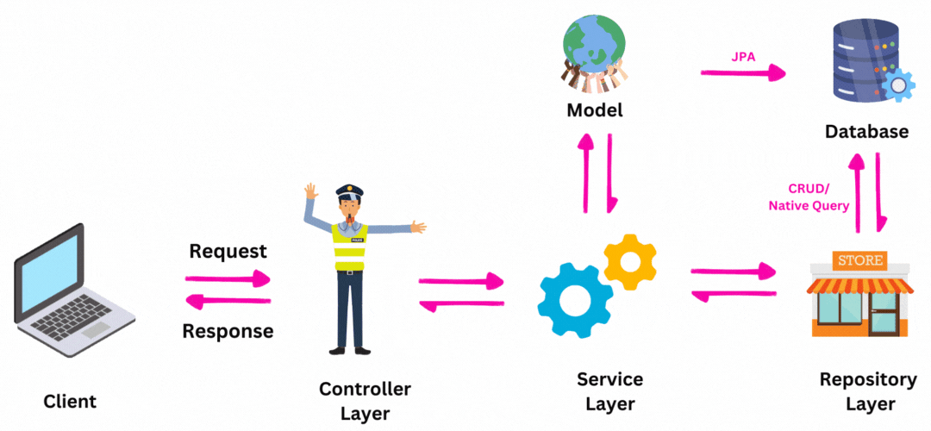
WHY SPRING BOOT?
Traditional Spring applications required a lot of boilerplate code and manual configuration (like XML files). Spring Boot solves this by:
Automatically configuring beans and dependencies.
Embedding servers, so no external
deployment is needed.
Providing default project setups.
Making applications easier to test and run.
When to Use Spring Boot
Building RESTful APIs
Developing microservices
Creating web applications
Prototyping quick applications
Replacing legacy applications with
modern Spring-based solutions

Slide 15
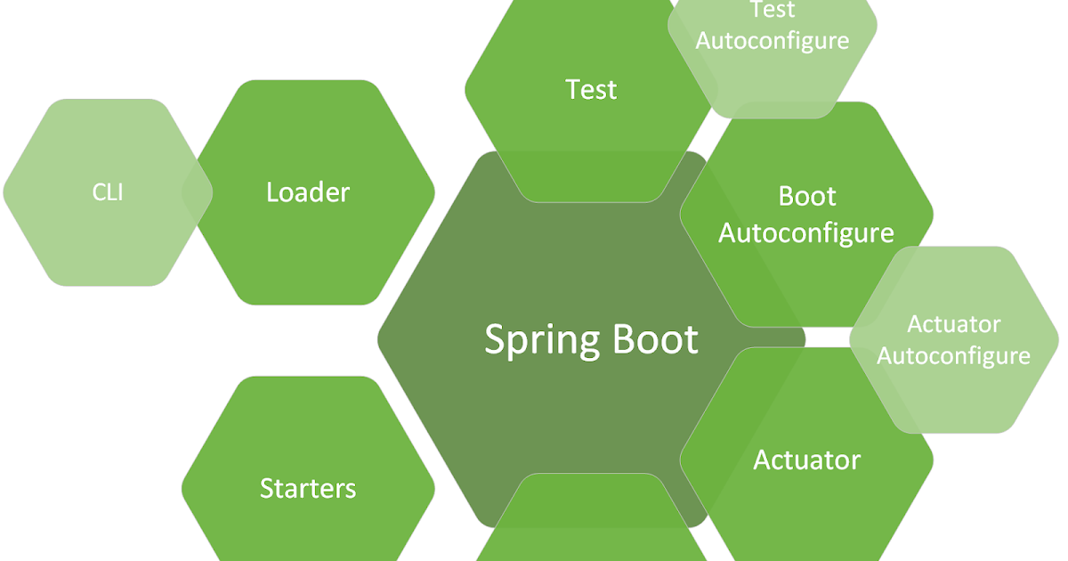
KEY FEATURES OF SPRING BOOT
✅ Auto Configuration
✅ Embedded Servers
✅ Spring Boot Starter Dependencies
✅ Spring Boot Actuator
✅ Externalized Configuration
✅ Spring Initializr
Benefits of Using Spring Boot:
Microservice-Friendly: Ideal for building microservices due to its modular structure and lightweight setup.
Integrated Testing Support: Includes testing libraries and annotations like @SpringBootTest for unit and integration testing.
Large Ecosystem: Integrates seamlessly with Spring projects like Spring Security, Spring Data, and Spring Cloud.
Reduces Boilerplate Code: Eliminates repetitive configurations.

Slide 16
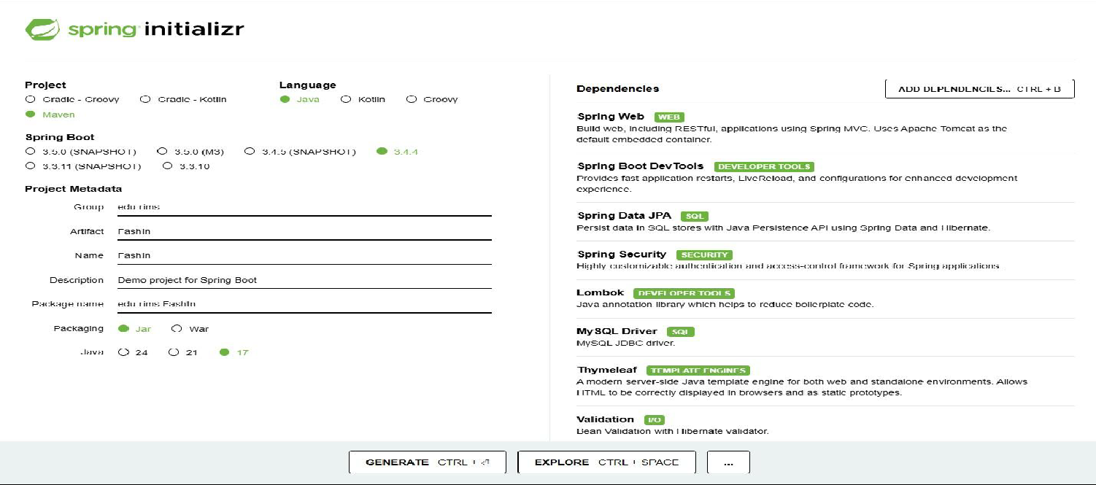
WORKFLOW OF SPRING BOOT
Go to Spring Initializr
Choose:
Project type (Maven/Gradle)
Language (Java/Kotlin)
Dependencies (e.g., Spring Web, JPA)
Download and import the project into an IDE.
Create a main class with
@SpringBootApplication.
Create REST controllers, services,
repositories.
Run with mvn spring-boot:run or
java -jar.

Slide 17
THYMLEAF IN SPRING BOOT
Thymeleaf is a server-side templating engine that works seamlessly with Spring Boot to generate dynamic HTML pages. Unlike traditional JSP (Java Server Pages), Thymeleaf allows developers to write clean, readable, and HTML-friendly templates, making it a popular choice for modern web development.
Thymeleaf is a powerful and flexible templating engine that simplifies web development in Spring Boot applications. Its HTML-friendly syntax, dynamic data binding, and tight integration with Spring MVC make it an ideal choice for creating interactive and data-driven web applications.
By using Thymeleaf, developers can easily manage front-end and back-end interactions, ensuring a seamless user experience without requiring heavy JavaScript frameworks. Whether you're building simple pages or complex web applications, Spring Boot with Thymeleaf provides an efficient, scalable, and maintainable solution.
HIBERNATE IN SPRING BOOT
Hibernate is a popular Object-Relational Mapping (ORM) framework for Java that simplifies database interactions by mapping Java objects (entities) to database tables. It eliminates the need for complex SQL queries and allows developers to work with Java objects instead of raw SQL queries.
In Spring Boot, Hibernate is used as the default JPA (Java Persistence API) implementation, making it easy to interact with databases using a simple and declarative approach.

Slide 18
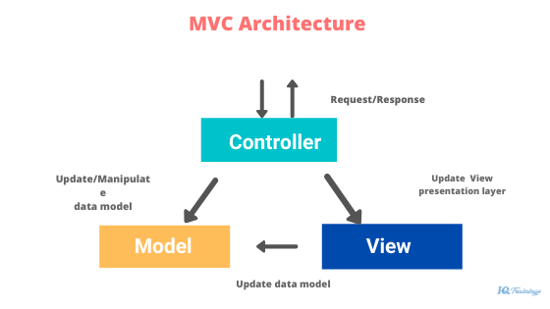
Controller in Spring Boot
In a Spring Boot web application, a Controller is a special Java class that handles HTTP requests from users and sends appropriate responses. It is a core component in the MVC (Model-View-Controller) architecture, where it acts as the middle layer that connects the front-end (user interface) and the back-end (business logic and database).
What Does a Controller Do?
Receives Web Requests: When a user visits a URL (like http://localhost:8080/hello),
Spring Boot maps that request to a method in the controller.
Processes Input (if any): It can take input from the user through query
parameters, path variables, or request bodies.
Calls Business Logic: The controller doesn’t usually contain complex logic itself.
Instead, it calls methods from the service layer to process the request.
Returns a Response: Based on the result, the controller returns a response, which can be:
JSON/XML (in APIs)
An HTML page (in traditional web apps)

Slide 19
CONTINUE…
Common Annotations Used in Controllers
Annotation | Purpose
@Controller | Defines a controller that returns a view (HTML)
@RestController | Returns data (like JSON) directly in the response
@RequestMapping | Maps the base URL path for a controller
@GetMapping | Handles HTTP GET requests
@PostMapping | Handles HTTP POST requests
@PathVariable | Binds URL parameters to method arguments
@RequestParam | Binds query parameters (?key=value) to method arguments
@RequestBody | Binds request JSON to Java objects

Slide 20
CONTINUE…
Entity Class in Spring Boot
In Spring Boot, an Entity class is a Java class that maps to a table in a database. It is a core concept in JPA (Java Persistence API) and is used to define the structure of the data you want to store and retrieve from the database.
✅ Purpose of an Entity Class
Represents a table in the database.
Each instance of the class represents a row in the table.
The fields (variables) in the class map to the columns of the table.
Entity classes are managed by Spring Data JPA
to perform CRUD operations easily
How to Define an Entity Class
You create an entity by:
Annotating the class with @Entity
Annotating the primary key field with @Id
Optionally using @GeneratedValue for auto-incrementing IDs
Using @Column to customize column names (optional)
Relationship Type | Example
@OneToOne | A user has one profile
@OneToMany | A customer has many orders
@ManyToOne | Many orders belong to one customer
@ManyToMany | A student can enroll in many courses, and each course has many students

Slide 21
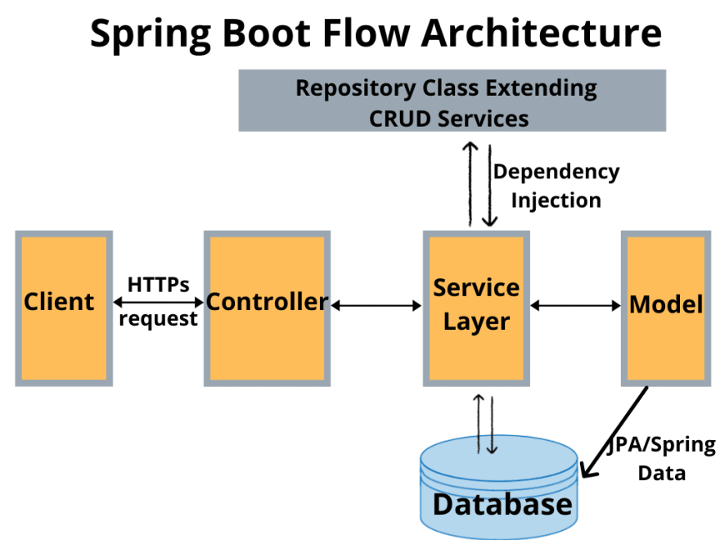
CONTINUE…
Repository in Spring Boot
In Spring Boot, a Repository is a special interface that helps you perform database operations (like save, delete, find, update) on your Entity classes without writing SQL code manually.
It is a key part of the Spring Data JPA module, which allows you to interact with databases using standard Java objects.
✅ What is a Repository?
A Repository is used to:
Access and manipulate data stored in the database
Perform CRUD operations (Create, Read, Update, Delete)
Query data using method names or custom queries
Instead of writing SQL queries, Spring Boot allows you to extend repository interfaces like JpaRepository or CrudRepository, and it generates the implementation for you at runtime.
A Repository in Spring Boot is a powerful and easy way to interact with the database. It takes care of all the heavy lifting related to data access so that you can focus on building business logic. With just a few lines of code, you can create full-featured data layers for any application.

Slide 22
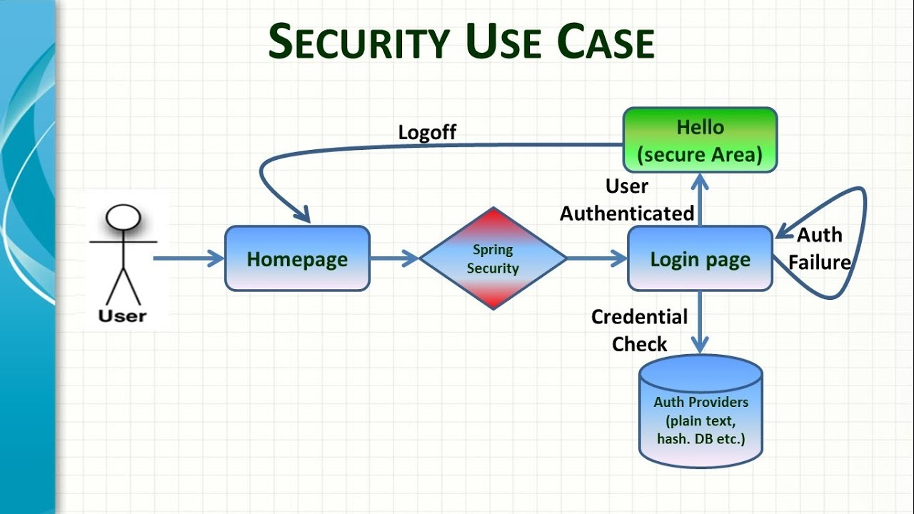
Spring Security
Spring Security is a powerful and customizable authentication and authorization framework for Java applications, especially those built with Spring Boot. It helps developers secure their applications from common security threats like unauthorized access, CSRF, session fixation, and more.
What Does Spring Security Do?
Spring Security helps you:
Authenticate users – Verify who the
user is (login).
Authorize users – Control what actions
a user can perform (roles/permissions).
Protect resources – Secure APIs, web pages,
or data based on user roles.
Prevent security attacks – Like CSRF, XSS,
and clickjacking.
Basic Setup in Spring Boot
All endpoints are secured by default.
Spring shows a default login page.
A default user with a generated
password is created

Slide 23
CONTINUE…
Security Features Spring Handles
Feature | Spring Security Handles
Authentication | ✅
Authorization | ✅
CSRF Protection | ✅
Password Encryption | ✅
Role-Based Access | ✅
Session Management | ✅
Custom Login/Logout | ✅

Slide 24
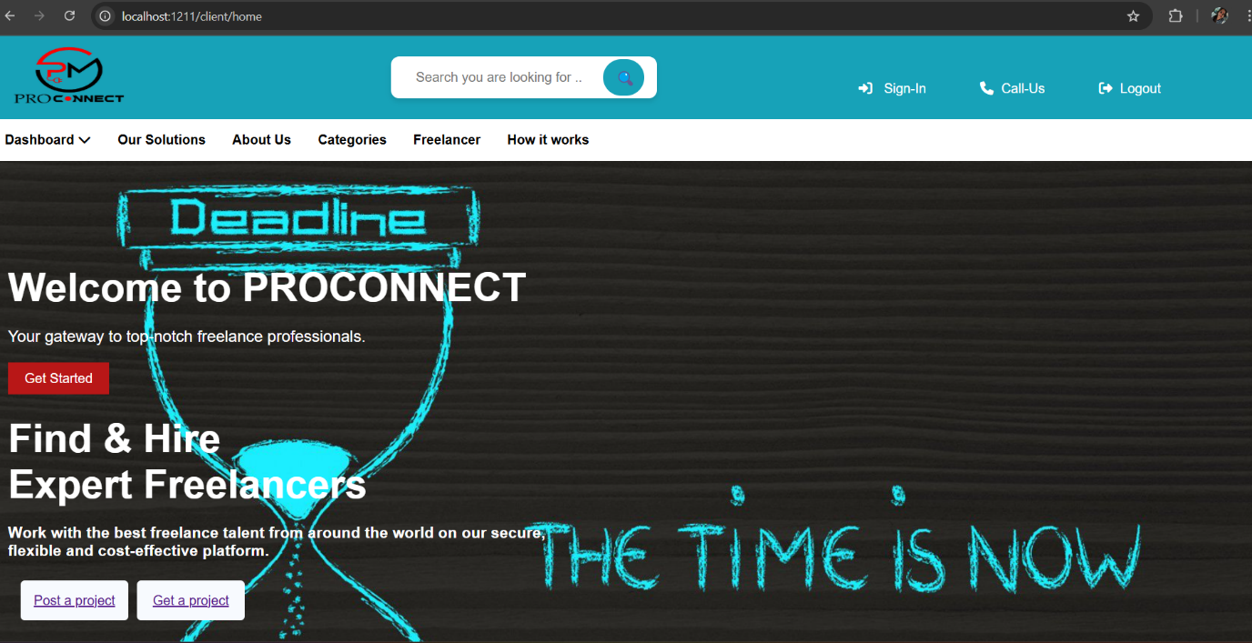
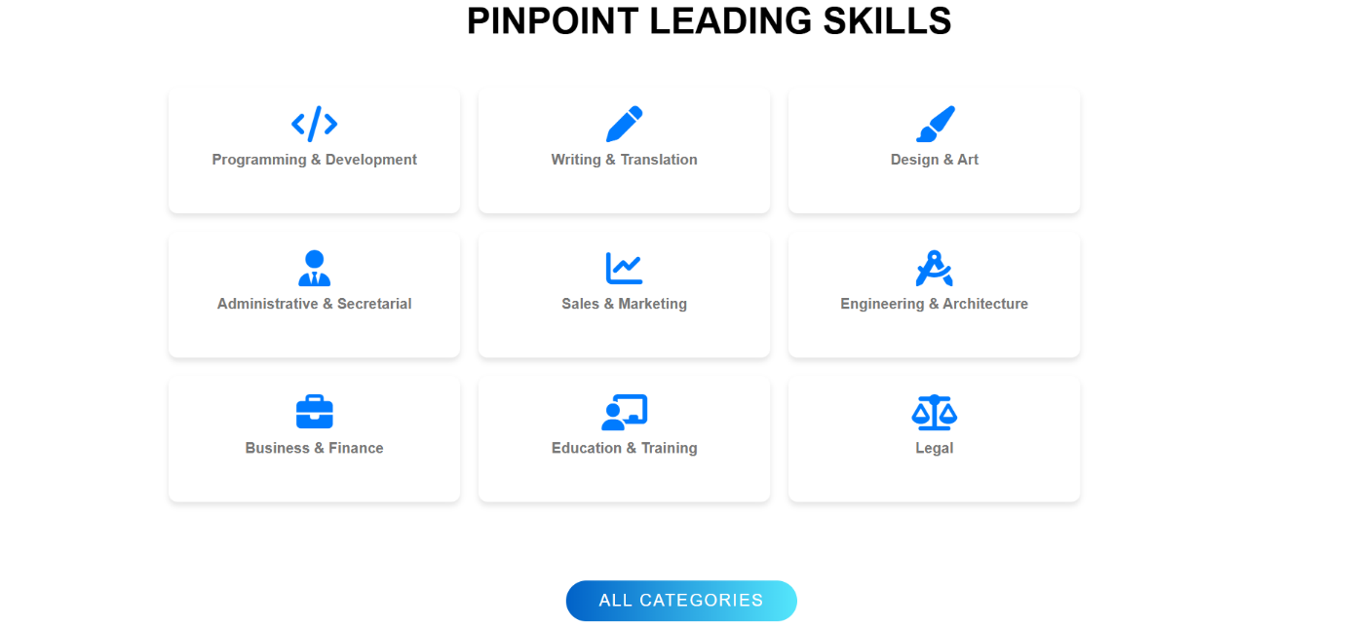
LANDING PAGE

Slide 25
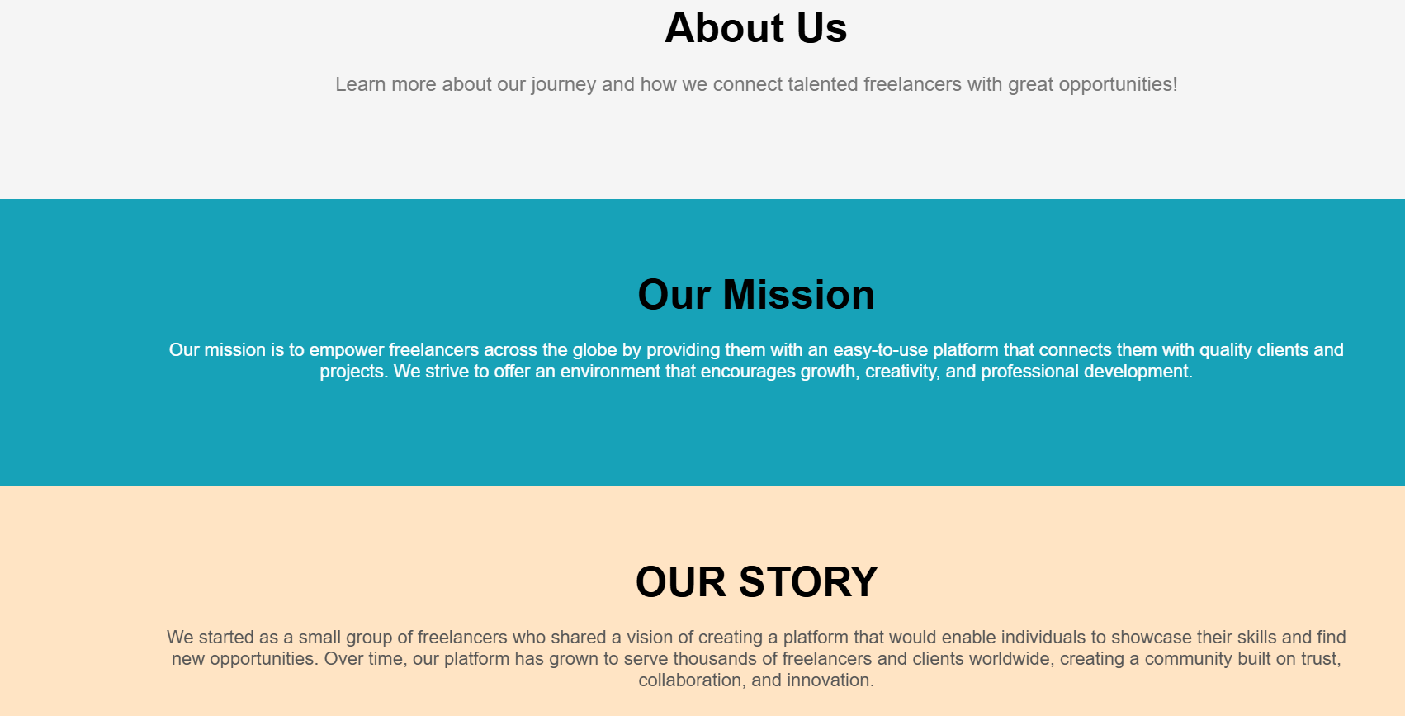
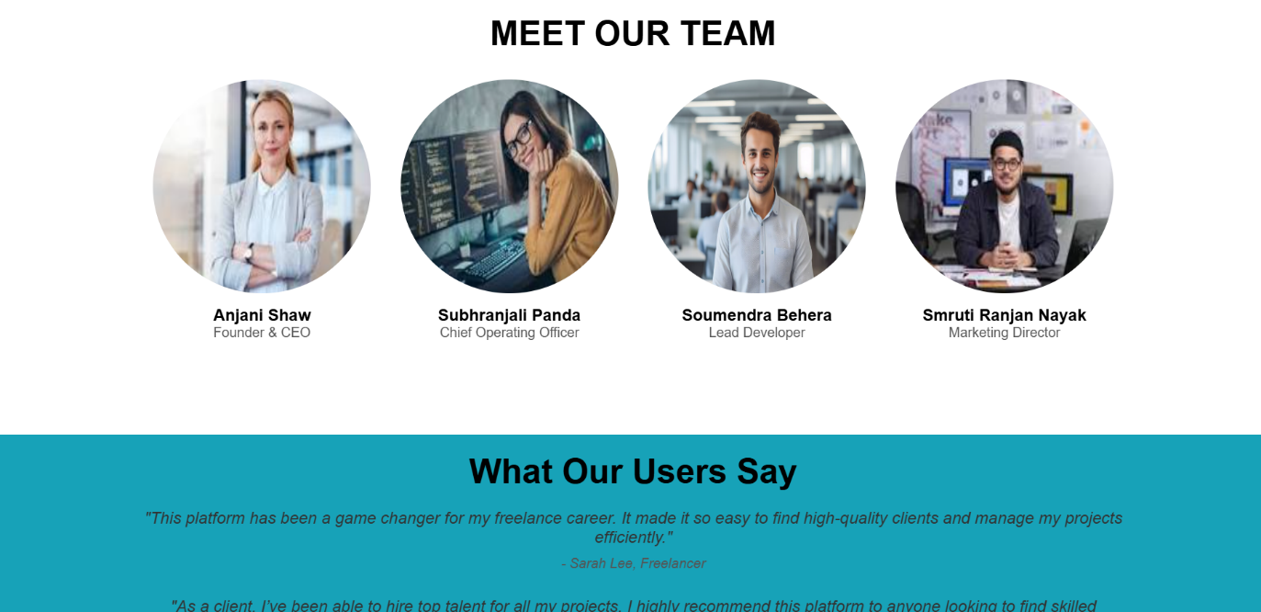
CONTINUE…

Slide 26
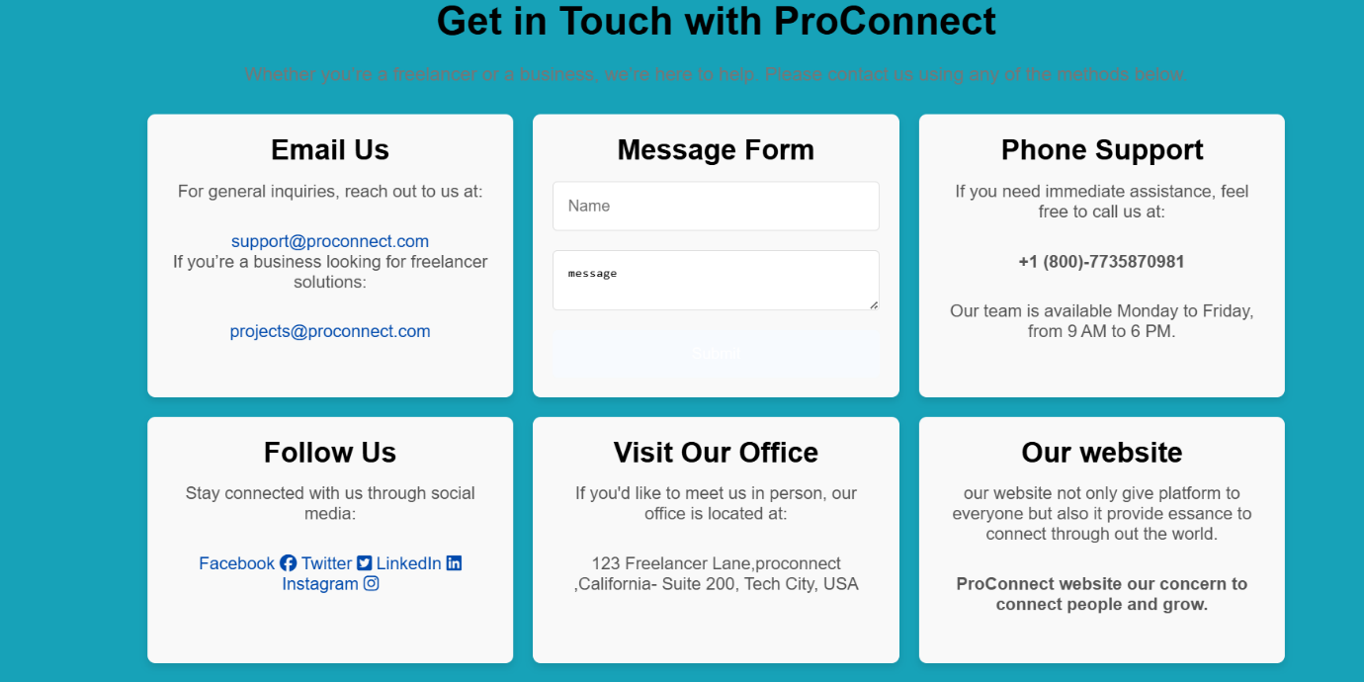
CONTINUE…

Slide 27
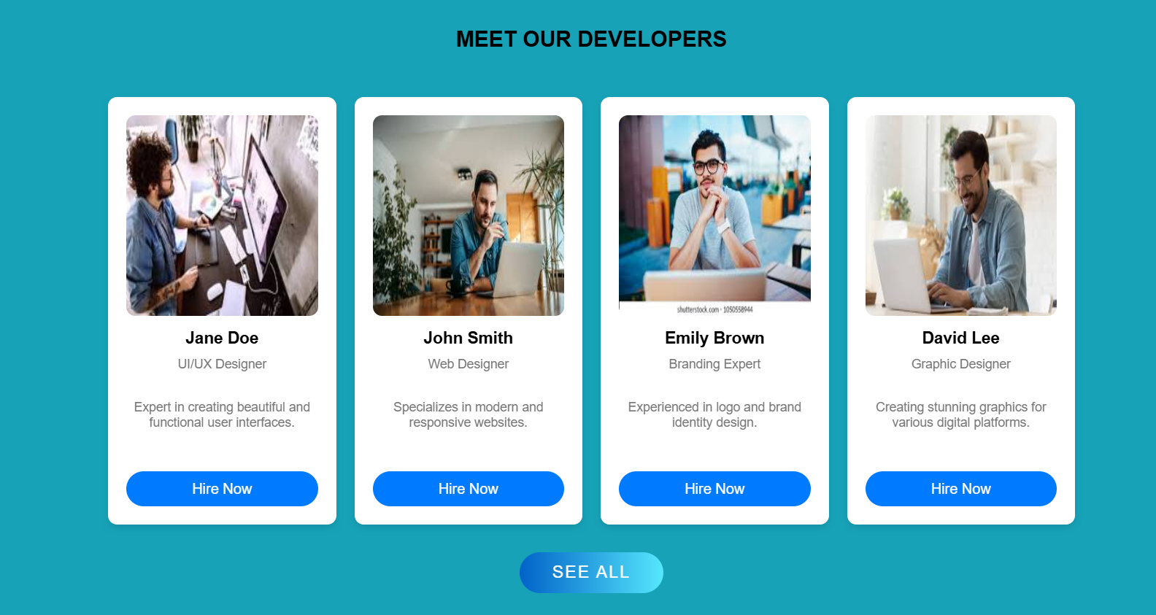
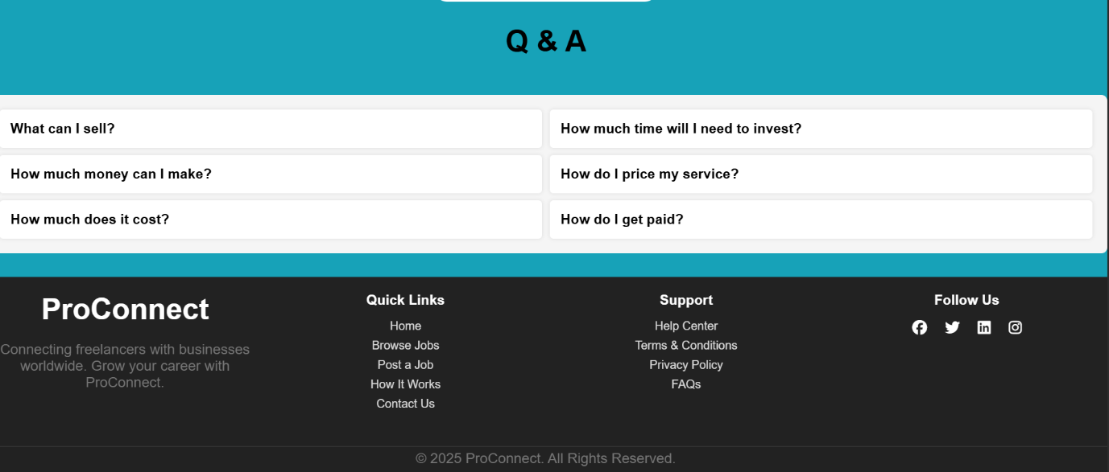

Slide 28
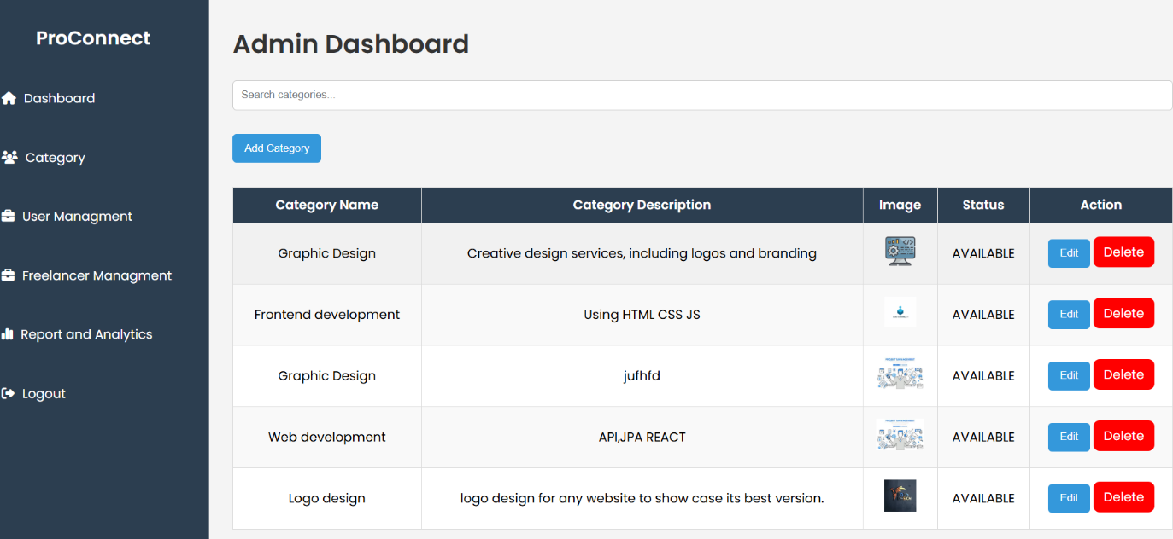
Key Functional Modules of the Admin Dashboard
1. 📂 Category Management
Purpose: Ensure the platform maintains a clear structure by managing the available categories under which clients post projects and freelancers offer services.
Functionality:
Add new categories
Edit existing category names or descriptions
Delete or deactivate unused or spammy
categories
Organize categories into parent–child
Benefits:
Keeps the marketplace organized
Allows for scalability by adding new industry
sectors

Slide 29
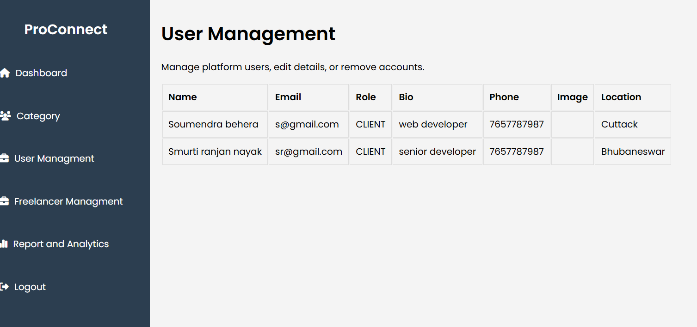
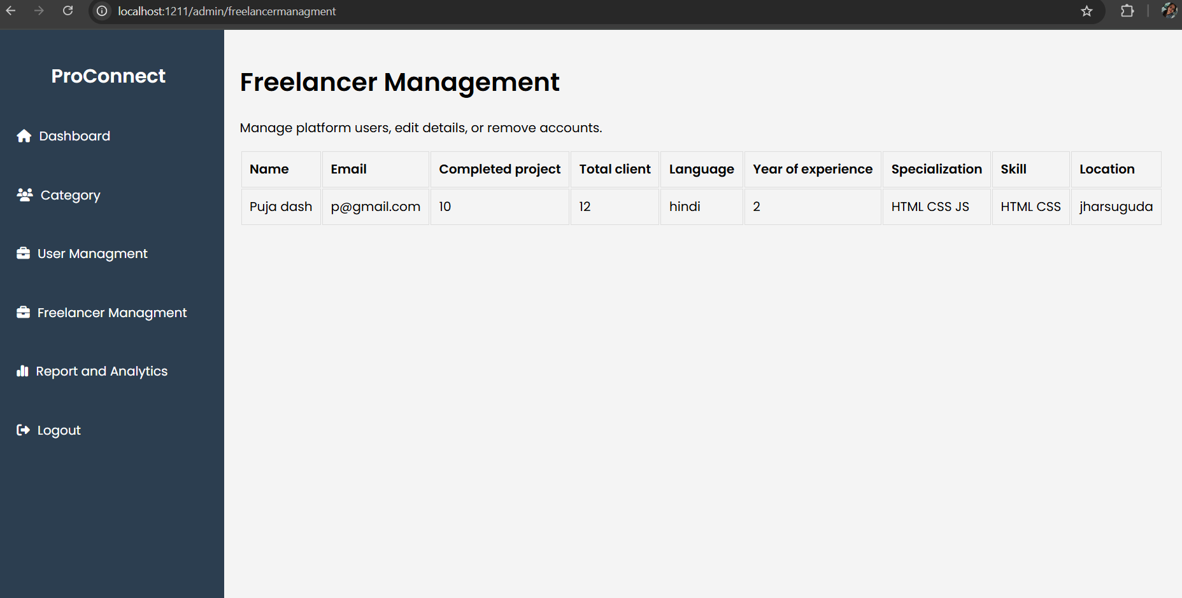
CONTINUE..
2. 👥 User & Freelancer Management
🔸 User (Client) Management
View list of all registered clients
Search by name, email, registration date, status
Activate, deactivate, or ban accounts
View client profile, project activity, and reports
Handle reported users (flagged by freelancers)
🔹 Freelancer Management
View list of all registered freelancers
Review profiles, skills, ratings, and job history
Approve or reject profile updates or verifications
Ban accounts involved in misconduct
Review service request patterns or spam reports
Benefits:
Ensures safety and trust in the community
Helps moderate inappropriate behavior or spam

Slide 30
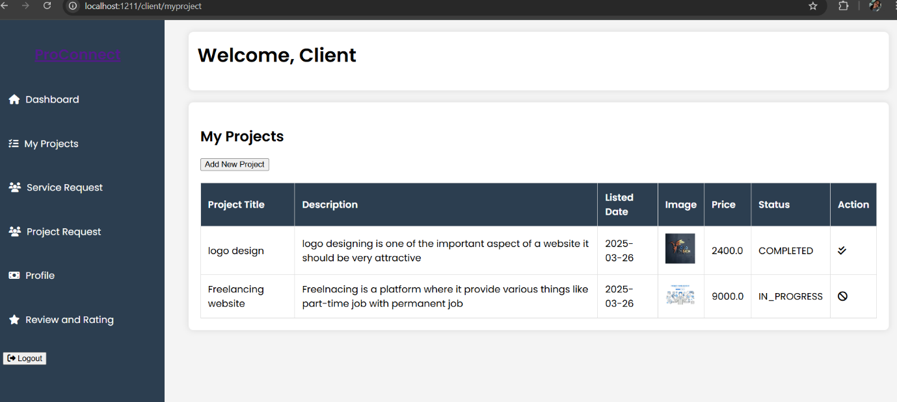
Key Functional Modules of the Client Dashboard
1. 🗂️ Add Projects by Category
Functionality: Clients can create and post new projects under specific predefined or custom categories (e.g., Web Development, Graphic Design, Content Writing).
Project Details Include:
Project Title
Category (dropdown selection)
Budget range
Description & objectives
Required skills
Deadline or time duration
Attachment (optional)
Benefits:
Helps freelancers filter and find relevant jobs
Keeps the platform organized by domain expertise

Slide 31
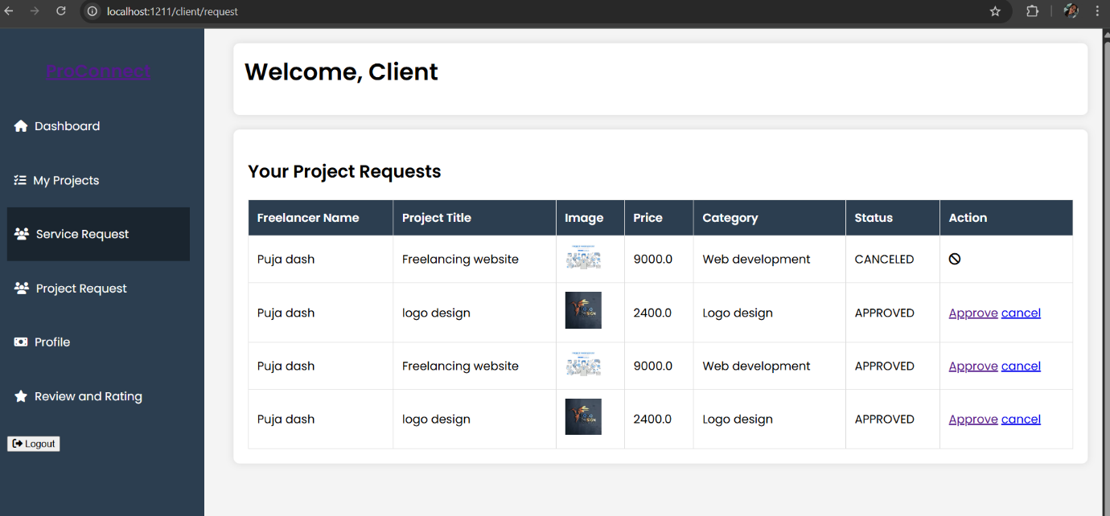
CONTINUE…
2. 📩 View Service Requests from Freelancers
Functionality:
Freelancers can send requests to work on projects
posted by the client.
The dashboard displays a list of incoming
service requests with:
Freelancer name & profile preview
Proposed rate / quote
Message or proposal content
Skills and previous reviews (if available)
Client Actions:
Accept / Reject request
View freelancer profile in detail
Message the freelancer directly for discussion

Slide 32
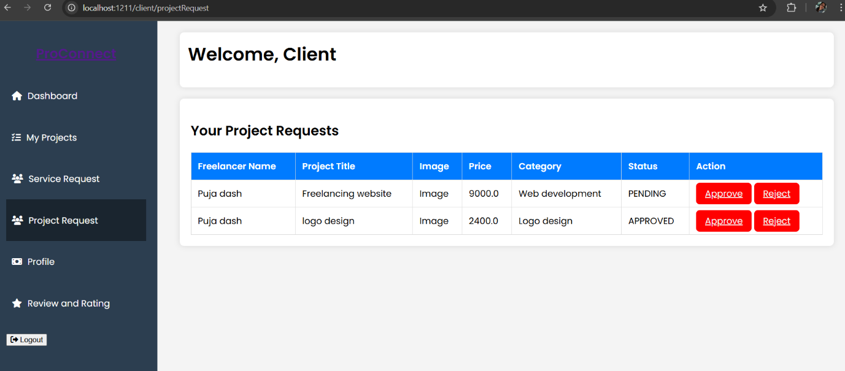
CONTINUE…
3. ✅ Oversee Project Completion Requests
Functionality:
After completing the assigned project, freelancers
can mark a Project Completion Request.
Clients are notified and can:
Review the submitted work/files
Approve or request changes
Release payment (if integrated)
Leave feedback/review
Status Tracking:
Track ongoing → under review → completed
→ archived status
Benefits:
Smooth workflow with accountability for both parties
Ensures proper delivery before marking a job as complete

Slide 33
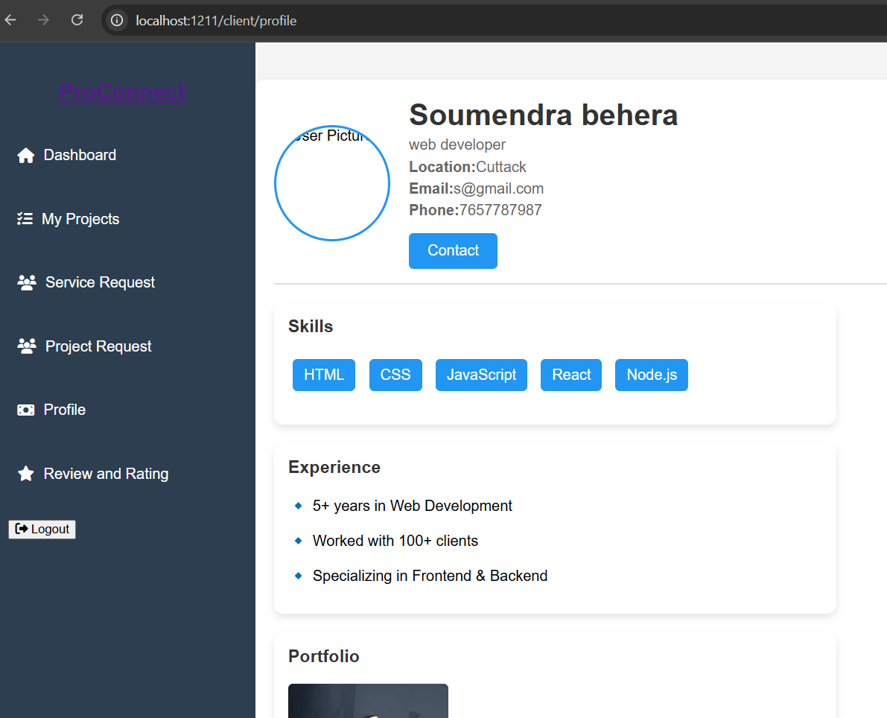
CONTINUE…
4. 🧑‍💼 Client Profile Management
Functionality:
Clients can view and edit their personal or
business profile information:
Name / Company Name
Email, Contact Info
Profile picture or logo
Bio / Description
Preferred categories / skills
Location
Additional Features:
Upload documents (e.g., business verification,
brand guidelines)
Link social profiles (LinkedIn, website)

Slide 34
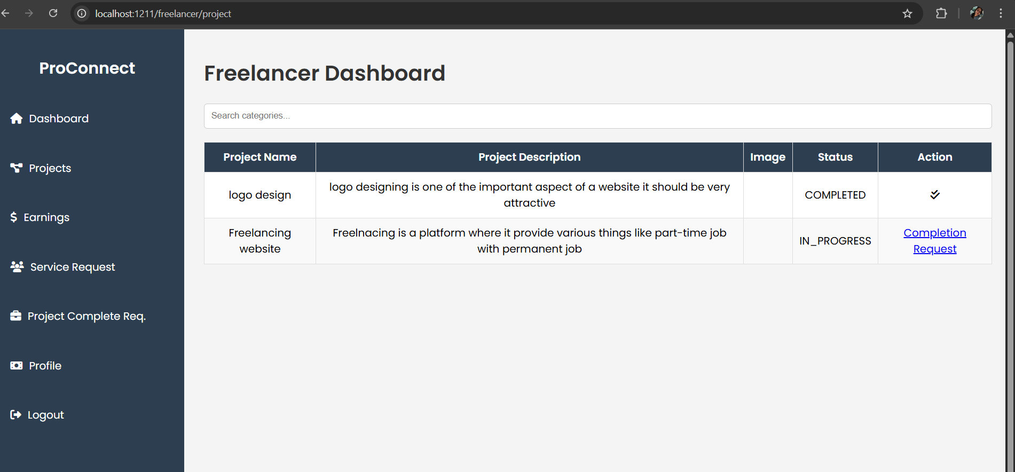
Key Functional Modules of the Freelancer Dashboard
1. 📥 Apply for Projects
Functionality:
Freelancers can browse and search for
projects posted by clients.
Apply for relevant projects by submitting a service
request which includes:
A proposal or message
Expected budget
Estimated timeline
Previous work or sample attachments
Benefits:
Easy way to pitch to clients
Helps freelancers find work suited to their skills and preferences

Slide 35
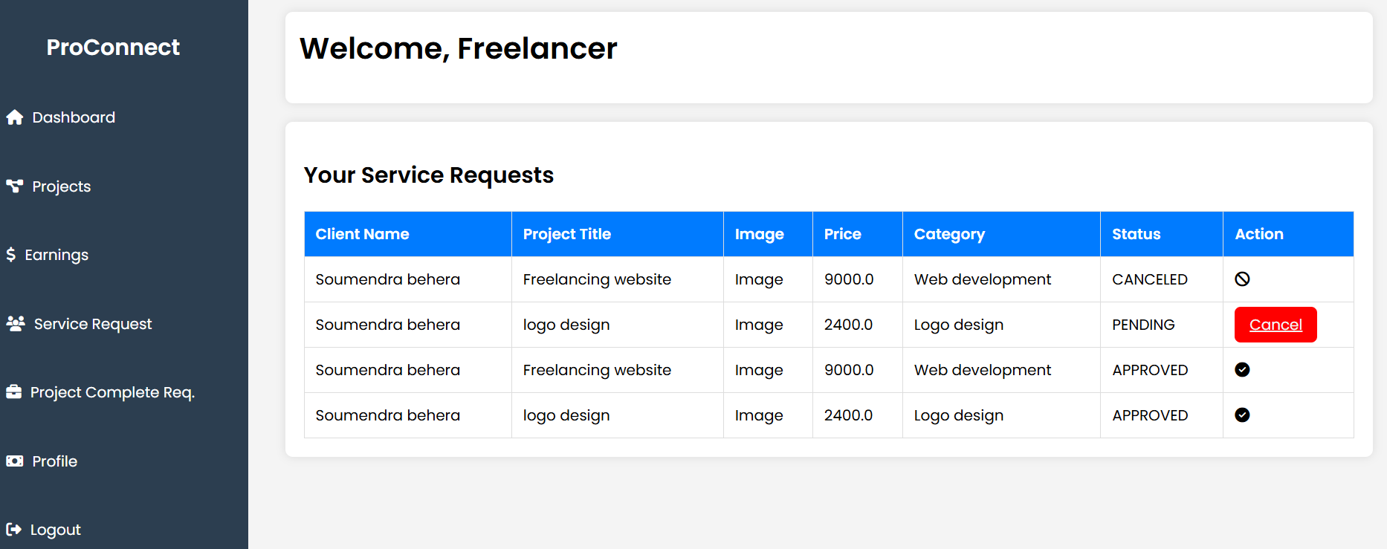
CONTINUE…
2. 📌 View Applied Project Requests
Functionality:
List of all projects the freelancer has
applied for
Each request displays:
Project title, category, client info
Date of application
Status (Pending / Accepted / Rejected)
Benefits:
Track the status of each application
Take follow-up action if required

Slide 36
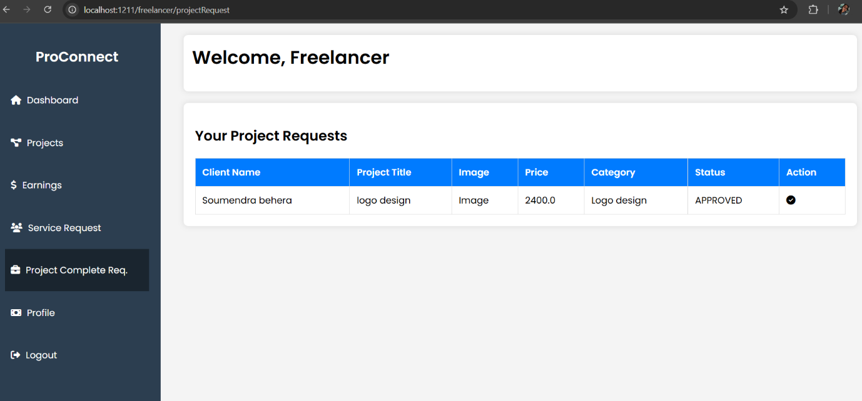
CONTINUE…
3. ✅ Approved Projects Management
Functionality:
Freelancers can view a separate
list of approved/accepted projects
Project details include:
Client name & contact
Full project brief
Deadline and agreed budget
Option to start work and
track progress

Slide 37
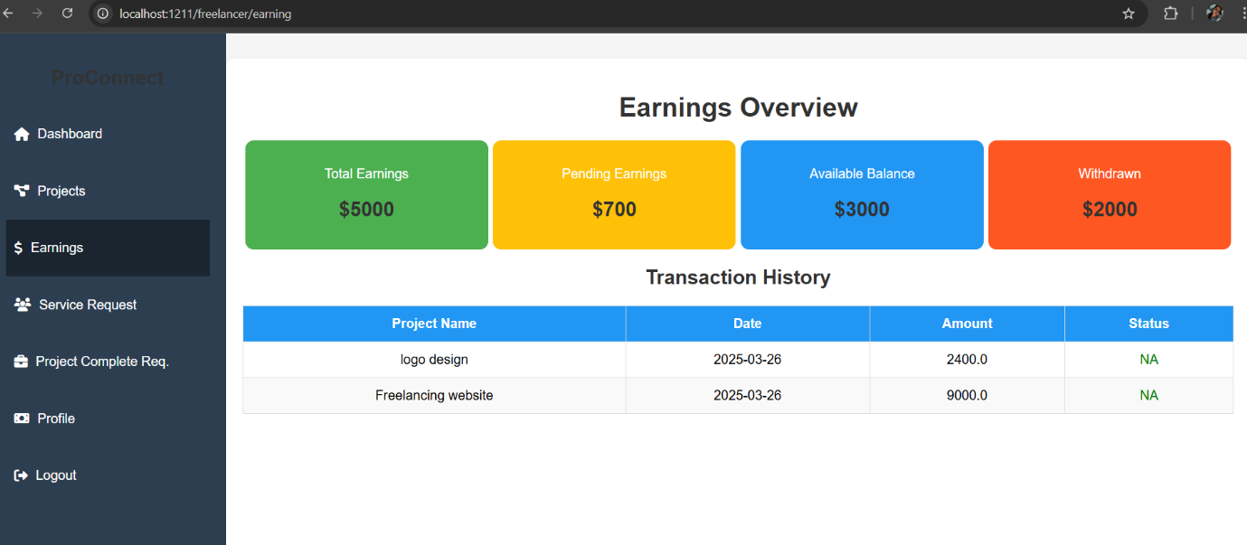
CONTINUE…
4. 🧾 Earnings Overview
Functionality: Freelancers can efficiently track their earnings with
the following features:
View total earnings from completed projects
Track pending payments awaiting client approval
Monitor payment release dates and transaction
history
Benefits:
Transparent and structured payout system
Ensures freelancers receive timely payments
for their work
Provides a clear breakdown of completed
and pending earnings

Slide 38

CONTINUE…
5. 📋 View Completed Projects
Functionality:
Freelancers can access a list of all projects marked as completed
Each project displays:
Client feedback
Ratings
Payment status (if applicable)
Downloadable copy of final submission (optional)
Benefits:
Acts as a portfolio of past work
Helps in profile credibility for future applications

Slide 39
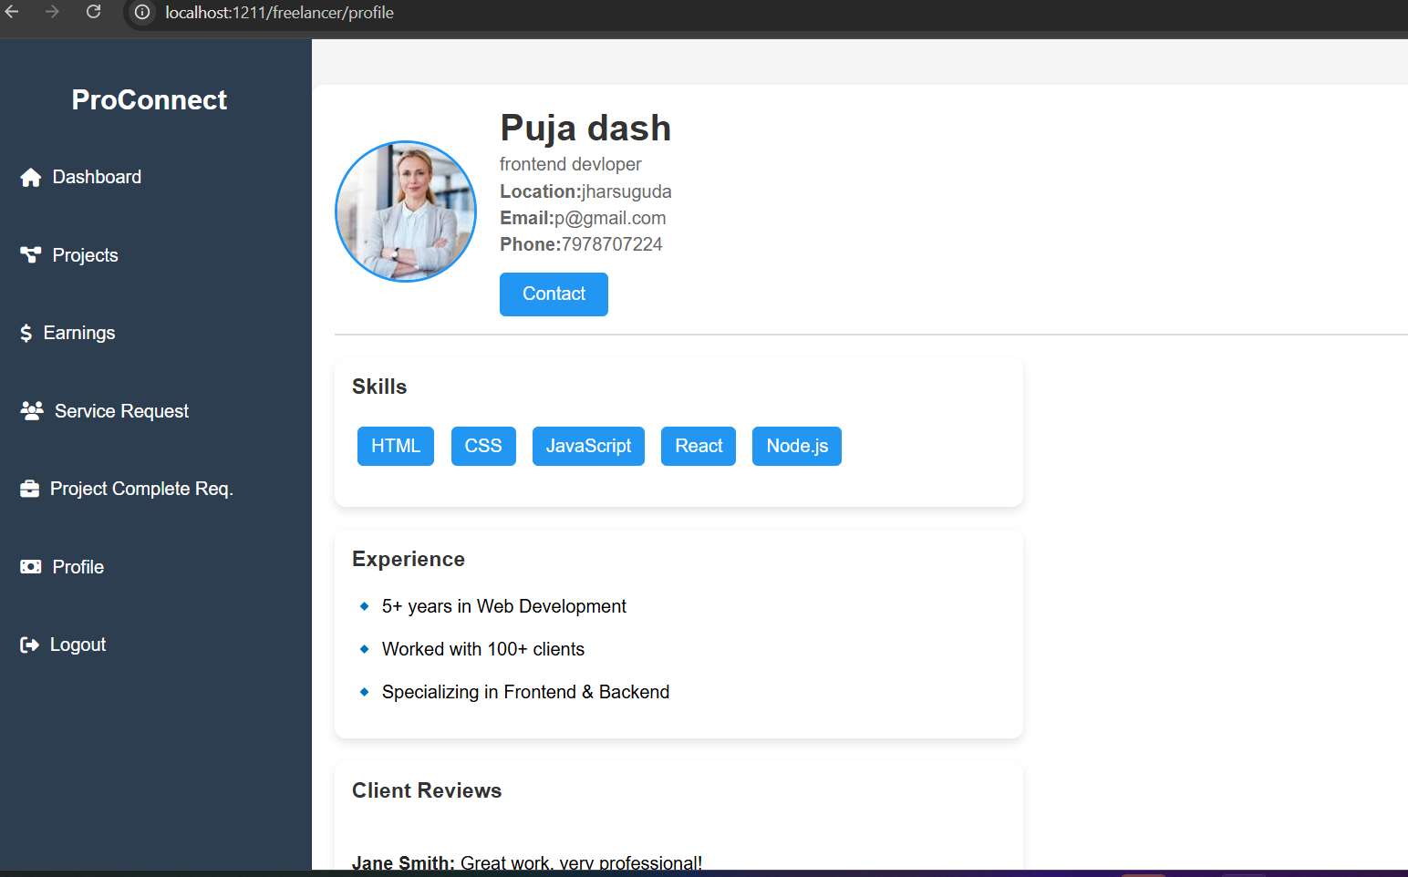
CONTINUE…
6. ✏️ Edit Freelancer Profile
Functionality:
Freelancers can manage and
update their profiles including:
Name, email, contact info
Bio / About section
Skills & services offered
Profile picture
Resume or portfolio links
Benefits:
Keeps their profile attractive to clients
Increases chances of being hired

Slide 40
CONCLUSION
ProConnect is more than just a platform — it's a bridge that seamlessly connects talented freelancers with clients seeking quality services. Designed with a user-centric approach, ProConnect empowers clients to post projects, manage workflows, and hire the right professionals, while offering freelancers a dynamic space to showcase their skills, apply for projects, and grow their careers.
With dedicated dashboards for clients, freelancers, and administrators, ProConnect ensures smooth communication, transparent transactions, and an efficient project lifecycle. From category-wise project posting and service request handling to analytics and profile management — every feature is built to foster trust, productivity, and professional growth.
ProConnect aims to revolutionize the freelance marketplace by creating a smart, secure, and scalable environment where work meets opportunity.

Slide 41
REFERENCES
Open-Source & Online Projects for Reference
⦁ GitHub Open-Source Freelancing Projects – Used to study the architecture of existing freelancing platforms.
https://github.com
⦁ Online Freelancing Platform Case Studies – Research papers and real-world examples.
Upwork
Fiver
Linkedln
AI-Based Assistance & Research
⦁ ChatGPT (OpenAI) – Used for structuring project documentation, refining explanations, and debugging.
https://chat.openai.com

Slide 42
CONTINUE…
YouTube Tutorials & Online Learning
⦁ Java Techie (YouTube Channel) – Used for Spring Boot, Hibernate, REST APIs, and authentication tutorials.
⦁ https://www.youtube.com/@JavaTechie
⦁ Code With Durgesh (YouTube Channel) – Spring Boot and Hibernate tutorials.
⦁ https://www.youtube.com/@CodeWithDurgesh
⦁ Programming with Mosh – Java, frontend, and backend development tutorials.
⦁ https://www.youtube.com/c/programmingwithmosh
UI/UX & Frontend Development
⦁ W3Schools – Quick references for HTML, CSS, JavaScript, and responsive design.
https://www.w3schools.com
⦁ Tailwind CSS – Utility-first CSS framework used for styling.
https://tailwindcss.com

Slide 43
CONTINUE…
Search Engines & Documentation
⦁ Google – Used for general research, troubleshooting, and finding relevant documentation.
https://www.google.com
⦁ Spring Boot Official Documentation – Comprehensive reference for Spring Boot, MVC, security, and REST API development.
⦁ https://spring.io/projects/spring-boot
⦁ MDN Web Docs – Used for HTML, CSS, JavaScript, and frontend-related concepts.
https://developer.mozilla.org
Security & Authentication References
⦁ Spring Security Official Guide – Used for authentication, authorization, and role-based access control.
⦁ https://spring.io/guides/gs/securing-web

Slide 44
THANK YOU !!!

